Slide 1
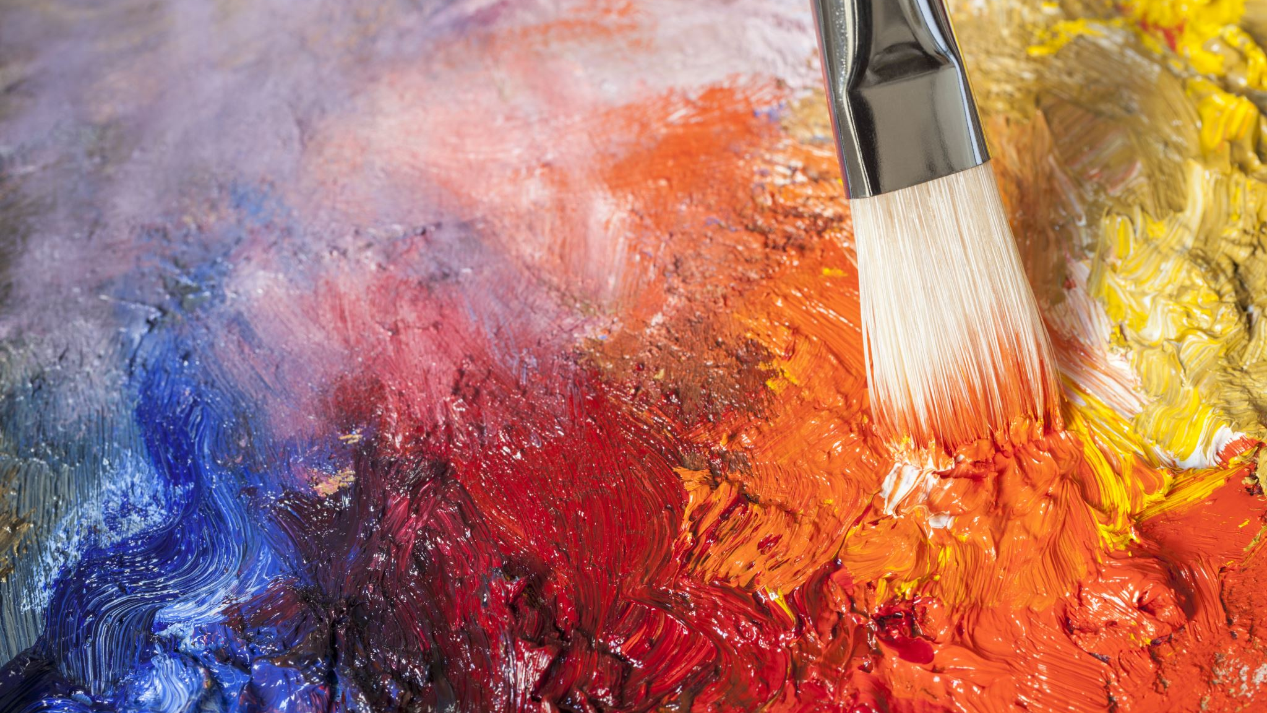
Farzi Van Gogh

Slide 2
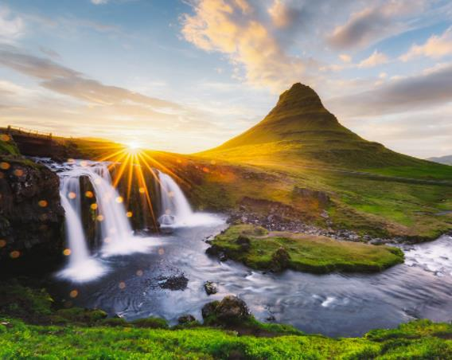
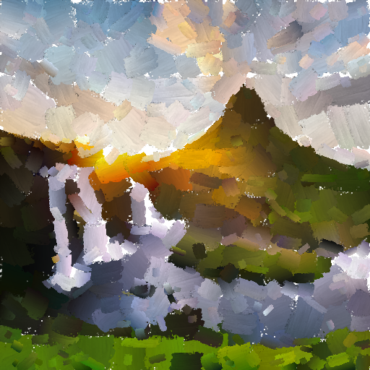
Task description
Generate a painted version of a target image, choosing a specific painting style (oil painting, water-color).
Utilize neural style transfer to apply the artistic style of a different reference image to the painted version.

Slide 3
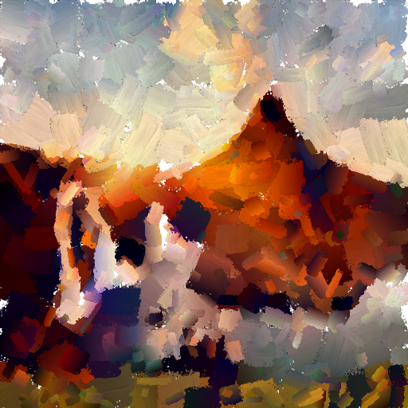
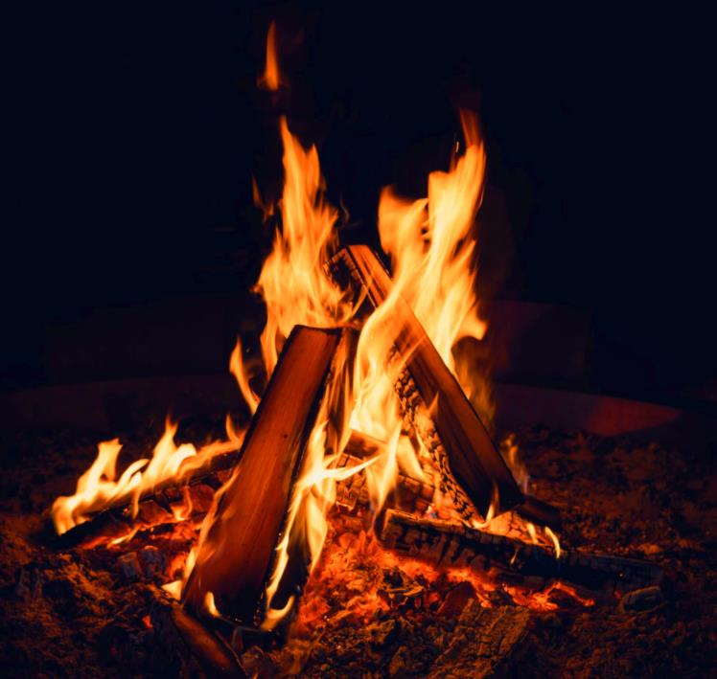
Approach
We built on the paper 'Stylized Neural Painting' by Zhengxia Zou and Co.
The paper gives separate frameworks for rendering an image as a style and then transferring into a particular style.

Slide 4
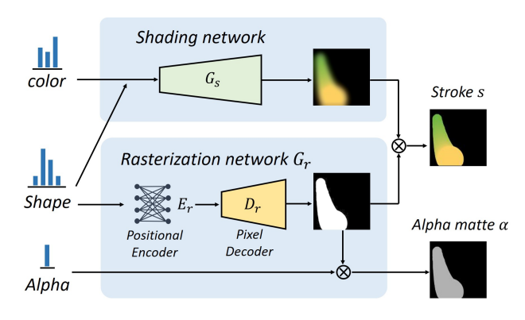
Renderer
The renderer has two parts, the shading network and the rasterization network
The shading network is used to generate the stroke colormap.
The rasterization network is used for generating the stoke silhouette.

Slide 5
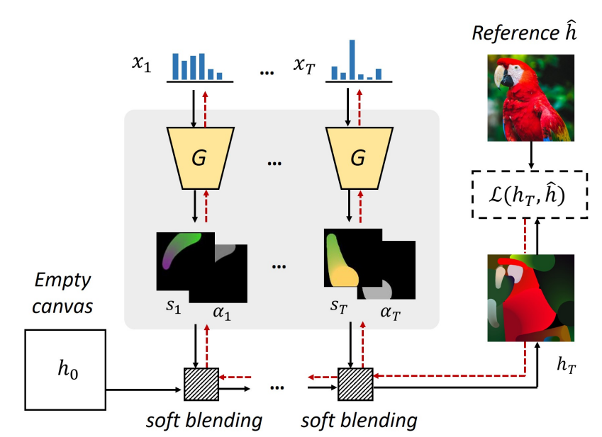
Image generation
For making the final rendered image, we start with a set of stoke parameters.
We generate an image by feeding these parameters into the trained renderer.
We now optimize these parameters using gradient descent.

Slide 6
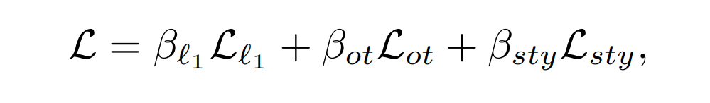
Loss function
For rendering the loss used is the sum of pixel l1 loss and a translation loss which the paper names as sinkhorn loss.
For style transfer we add a term of style loss to the above losses.
The style loss is calculated using the Grammian of the rendered image and the style image after passing through some layers of a pretrained VGG16 network.

Slide 7
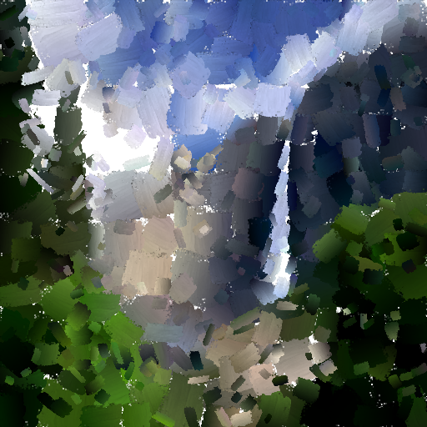
Major Contributions
Modifying loss function using Laplacian
Using a lightweight renderer architecture
Extending the implementation for videos

Slide 8
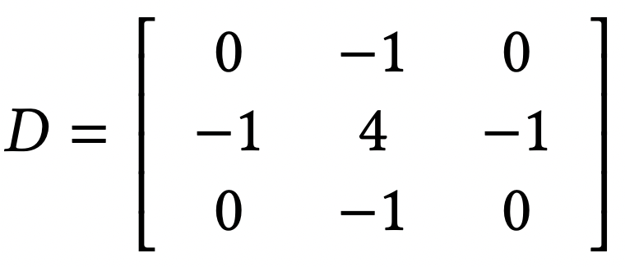
Laplacian
Inspired by Laplacian-Steered Neural Style Transfer by Shaohua Li and Co.
Incorporated Laplacian loss within neural style transfer to accentuate and sharpen edge features for enhanced visual definition.
Utilized the convolution process with a specified matrix 'D' to approximate the Laplacian of an image.

Slide 9
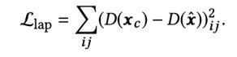
Laplacian Loss
Given two images x and y, we adapted the loss function by incorporating the contribution of L_{lap}- a metric used to assess the dissimilarity between the Laplacians of images x and y
This adjustment involved strategically introducing L_{lap} after specific layers in the VGG network, and taking their sum to get a modified loss function

Slide 10
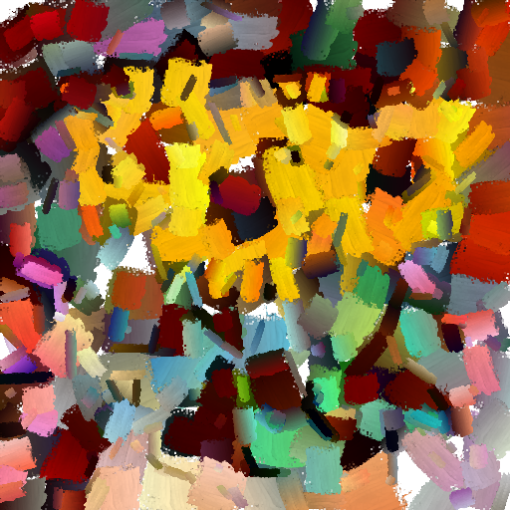
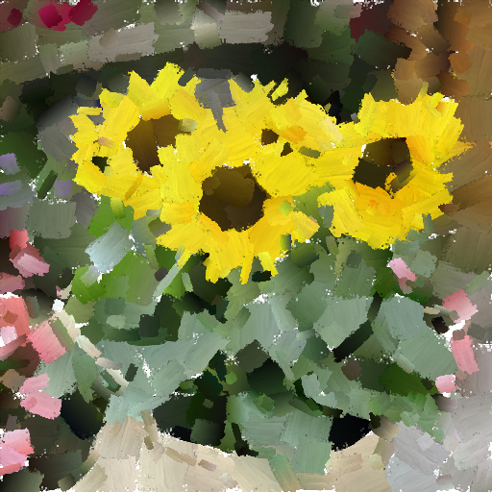
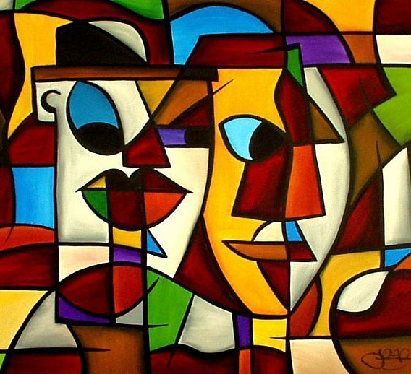
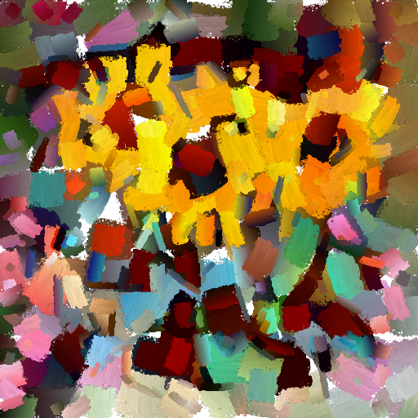
Without Laplacian
With Laplacian
Farzi Van Gogh
10

Slide 11
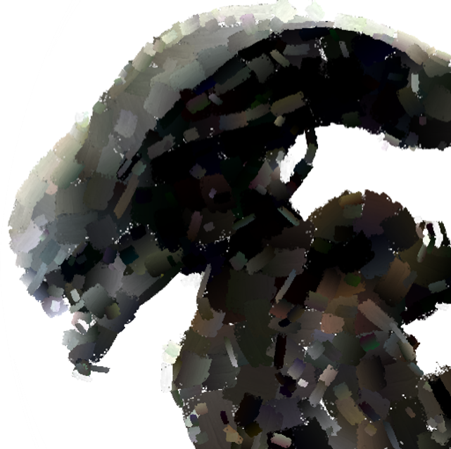
Lightweight Renderer
We designed both the shader and a rasterization network for a new renderer.
We significantly brought down the number of parameters from 18.1 million to 5.4 million, roughly 3 times.
We observe an approx. Speedup of 5% in the rendering of images

Slide 12
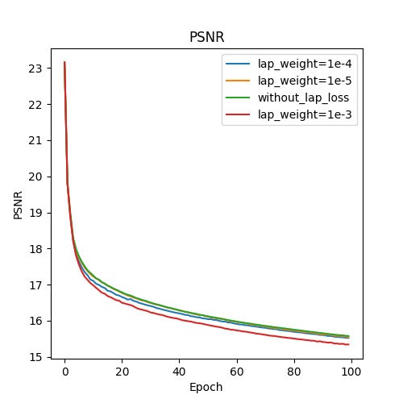
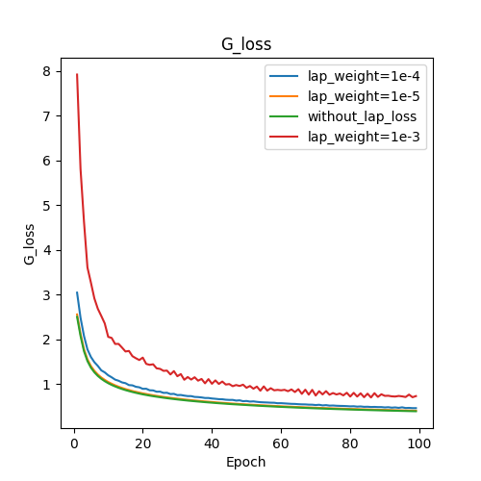
Comparing effect of Laplacian Loss

Slide 13
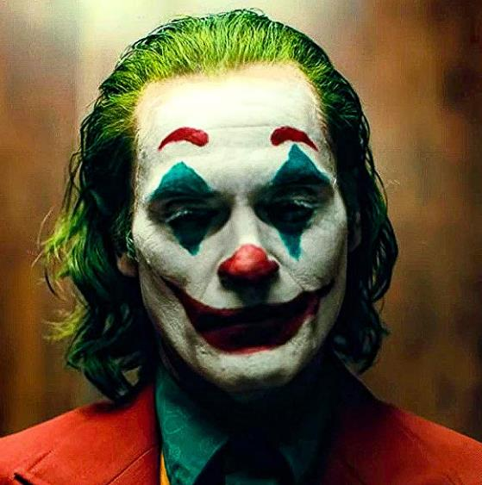
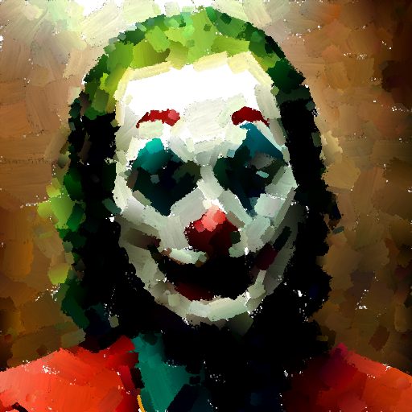
Our Render Network
Farzi Van Gogh
13

Slide 14
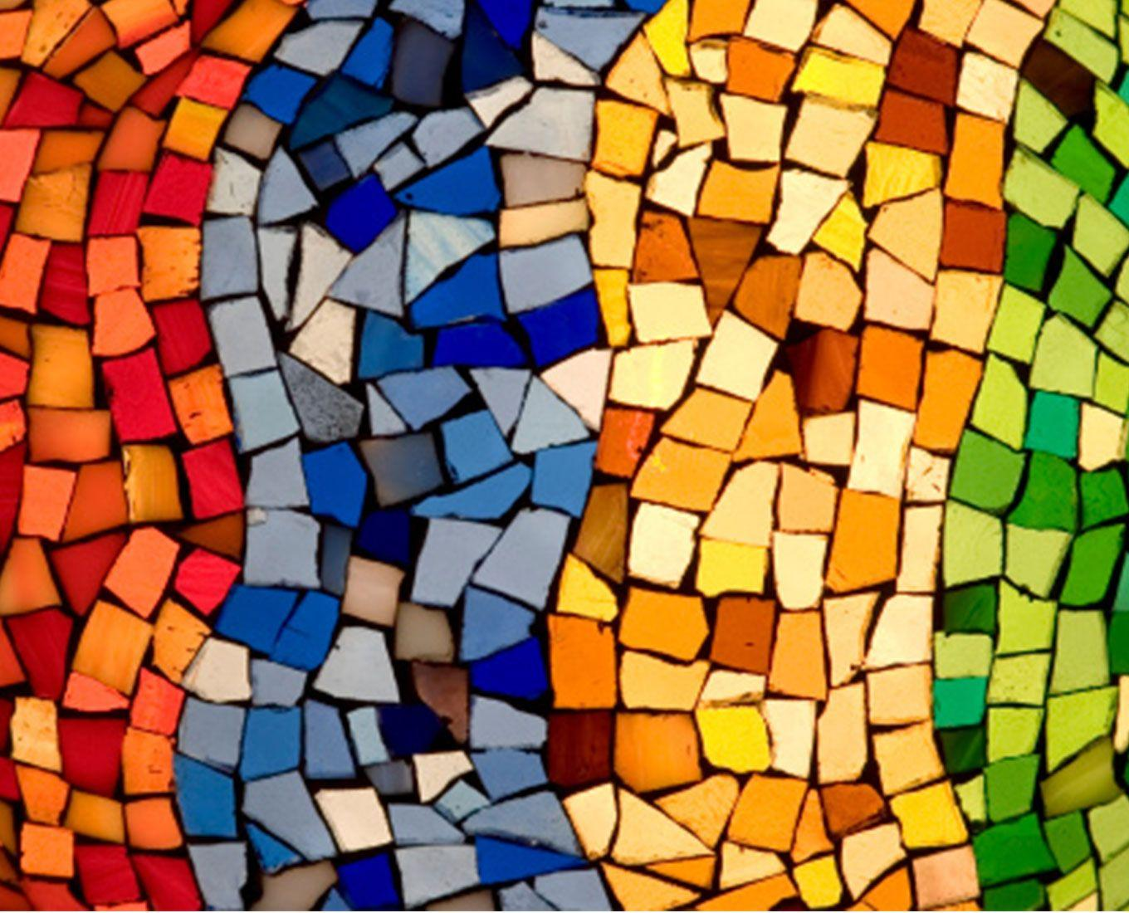
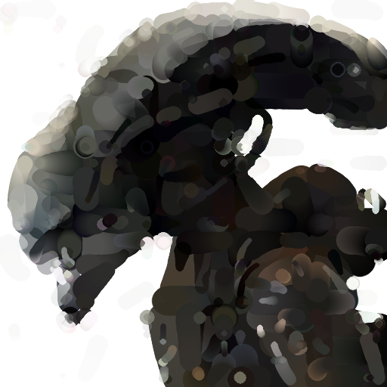
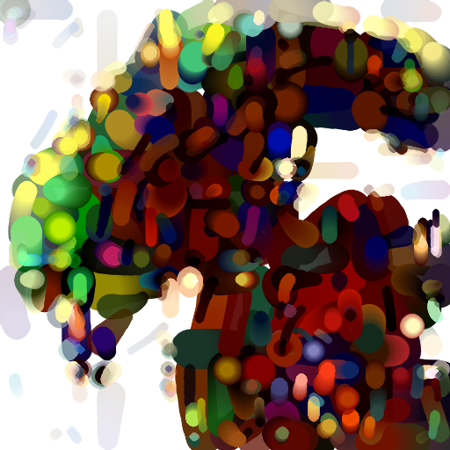
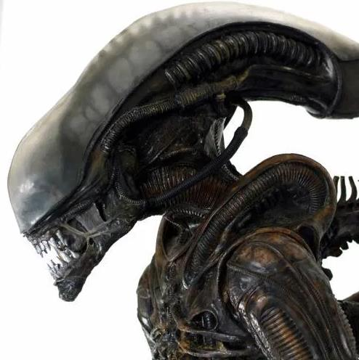
Water-color Rendered Image
Style Transferred Image

Slide 15
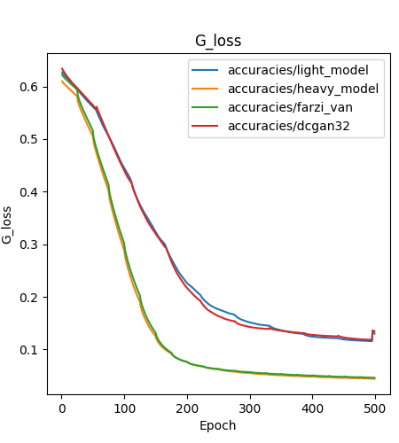
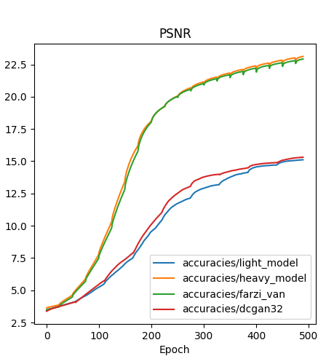
Comparison of Models

Slide 16
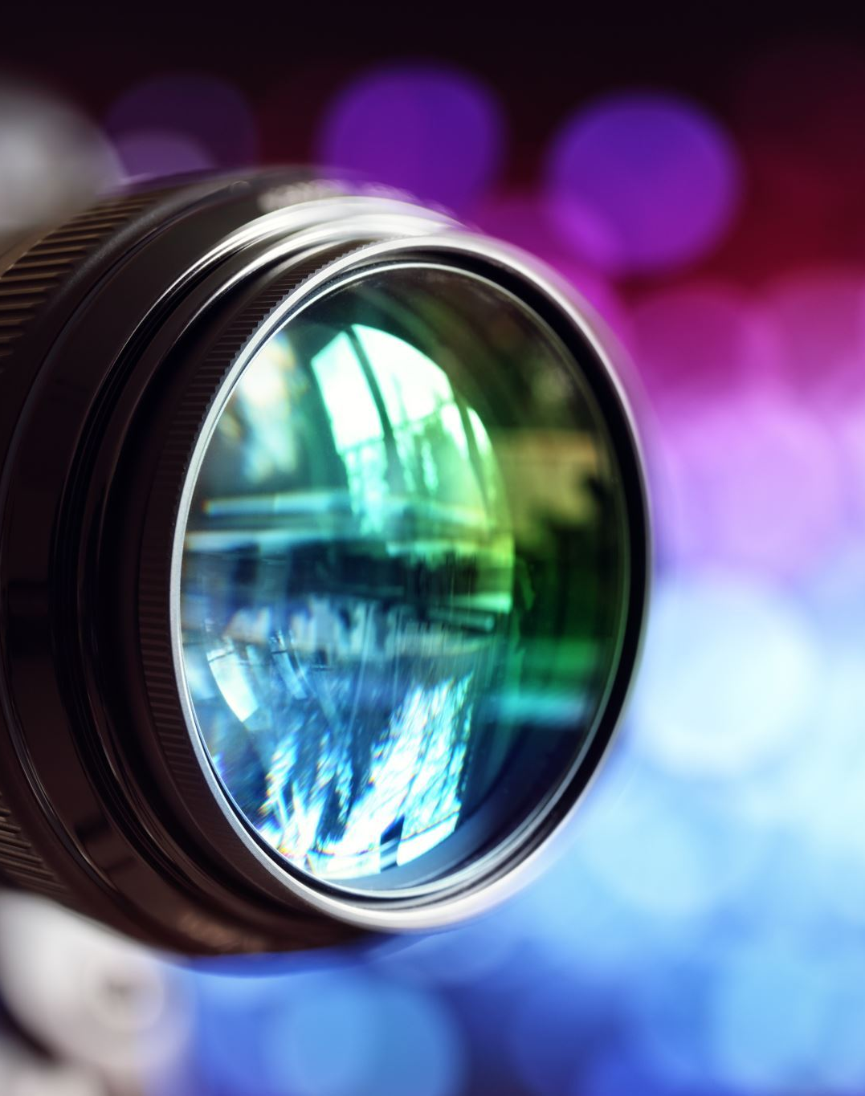
Video Style Transfer
We extended this style transfer framework to videos.
We added another interface that takes a video and renders it into a particular input style

Slide 17
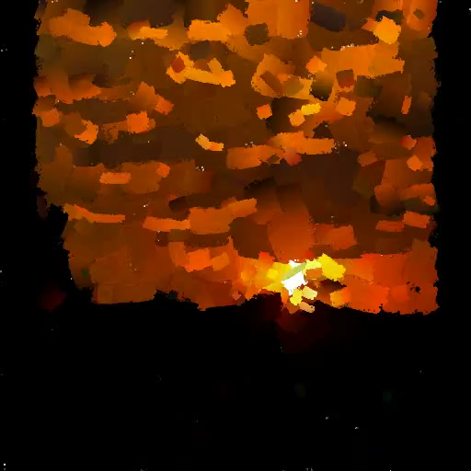
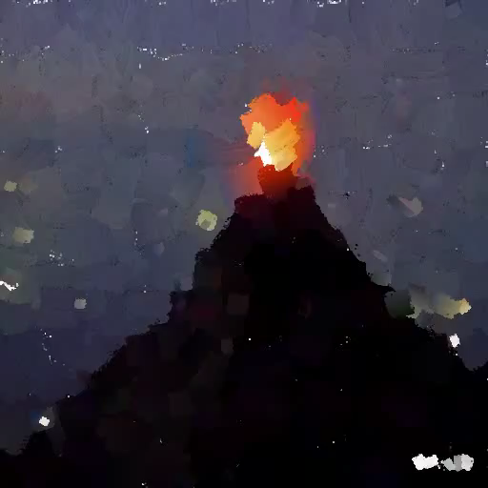

Slide 18
Other contributions
We sped up the existing code by adding vector operations in place of loops wherever possible, resulting in reduction of running time, a 7% speedup
We tried using other networks like VGG19 for calculating the style loss, we observed similar results across different architectures.

Slide 19
Changes made in code
Source Code Stylized Neural Painting
In loss.py added code for laplacian loss in VGGStyleLoss class.
Created the classes Shader, Rasterizer and Light-Net for building our renderer model.
Added VideoPainter class for implementing rendering transfer over Videos.
Created demo_video.py as an interface for video rendering.

Slide 20

Work Division
Ideation/Searching for related papers – Akshat, Soham
Analysing Base paper model and reproducing – Akshat, Ayush
Introduction of Laplacian – Ayush, Soham
Application to videos – Sankalan, Soham
New model with fewer parameters – Ayush, Sankalan
Trying new architecture like VGG19 in base model – Akshat, Sankalan
Code Optimization like vectorization – Andreas, Sankalan
Writing of scripts for data generation – Akshat, Andreas
Preparation of presentation/report - Andreas, Soham
Writing scripts for plotting - Andreas, Ayush

